Slide 1
Lending Club
Classifying Loan Defaults
Michael Cho and Sathya Muthukkumar
Github:
https://github.com/michaelcho1
https://github.com/picnicpanic

Slide 2
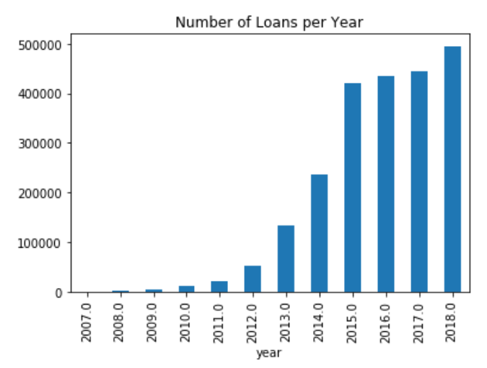
Lending Club Loans Analysis
Time Period: June 2007 - December 2018.
Loan Terms Offered: 36 months & 60 months.
Number of Loans Offered: 400K-500K loans in the past four years.
Default Ratio: ~80% pay back their loans vs. ~20% default.
Prepayment Risk: Out of the loans that are fully paid, 85-90% prepay.

Slide 3
Our Position
We analyze and model the data from the perspective of investment advisors.
We run available lending club loans through our model, and tell our client whether or not we believe it would be a safe investment.
Instead of working directly for Lending Club, we work for a client looking to invest in loans on Lending Club.
We use only features available to these clients to develop the models. (See appendix for details)

Slide 4
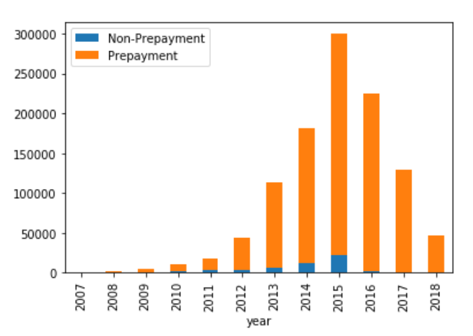
Lending Club Loans Analysis
Debtors pay for an average duration of 21 months.
The average term duration is 42 months.
Out of the loans that are fully paid, 85-90% prepay.
This means that the interest is less than if they paid over the full term.
This also means that defaults are partial, and in some cases, the debtor defaults at a point where their payment totals are higher than the principal.

Slide 5
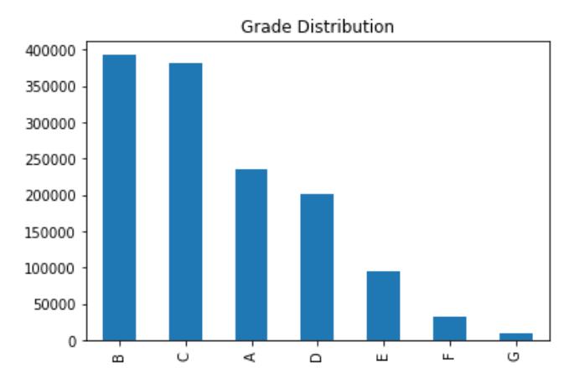
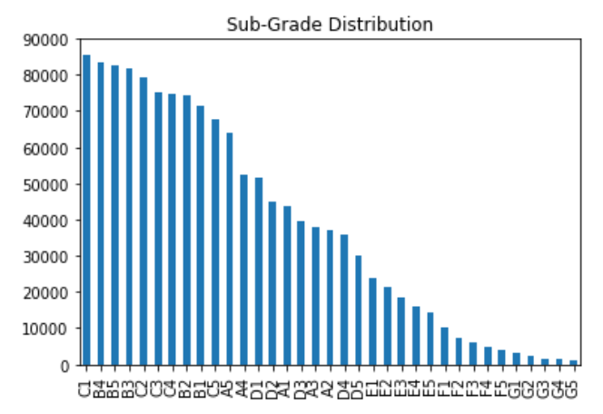
Lending Club Loans Analysis

Slide 6
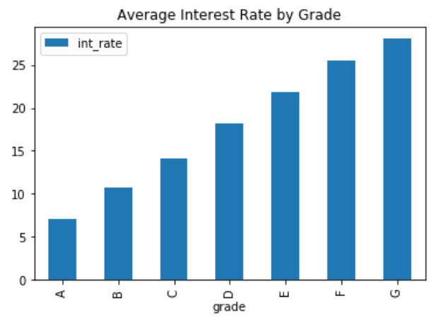
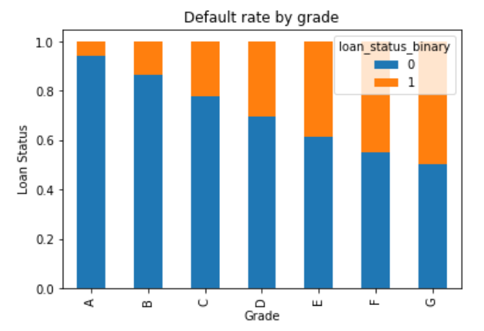
Lending Club Loans Analysis

Slide 7
Positioning and Scoring
How do we score our models? Which model do we use for each client? Given a certain amount of money, which model returns the best?
We took the total payment feature and subtracted the loan amount feature. This resulting value is negative for most defaults, and positive for all fully paid loans.
This new calculated column, the interest collected, is summed for each model where it predicts a non-default. Similarly the loan amount, or principal, is summed.
The ratio of these is our interest rate that the model scored, and is calculated on our test data.

Slide 8
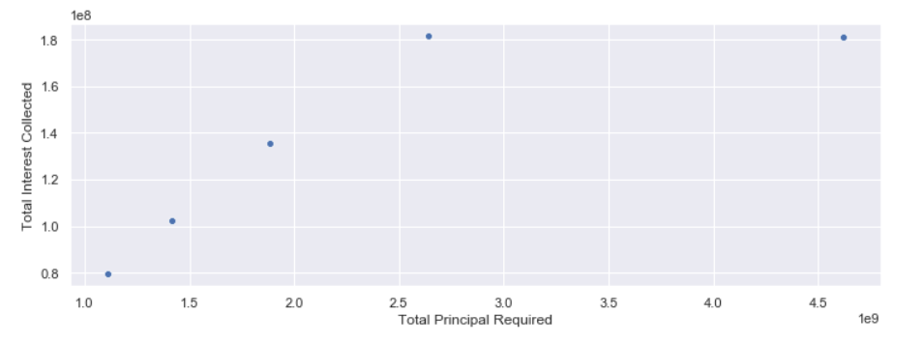
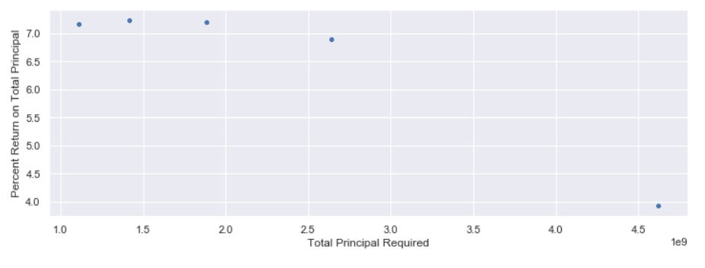
Model
We chose an XGBoost model.
Varying the class weight parameter yielded the most flexibility for us out of any other parameter.
Trade offs between percent interest returned, the raw value of interest returned, and the amount needed to be invested.

Slide 9
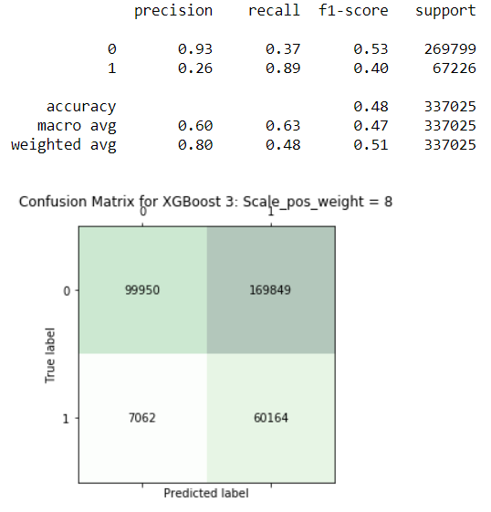
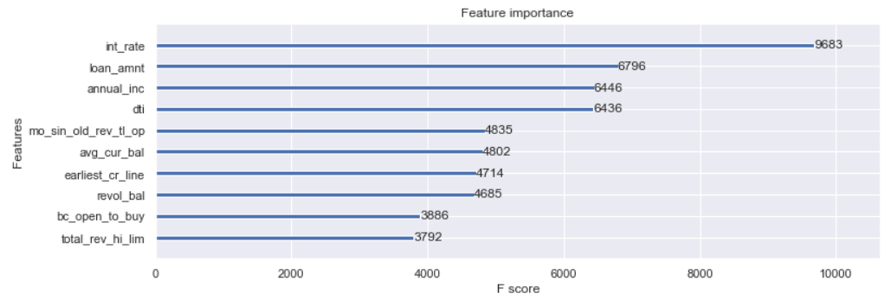
Model Cont.
There is a local maxima for percent interest returned based on different principals (by adjusting class weight). We chose this as our model. It returns 7.24% for a 1.4b investment.

Slide 10
Average Return on Investment
Annualized Returns
Risk Free Rate *
1.63%
Null Model
1.71%
Our Model
4.28%
*Average of 3yr and 5yr treasury yields.

Slide 11
Appendix

Slide 12
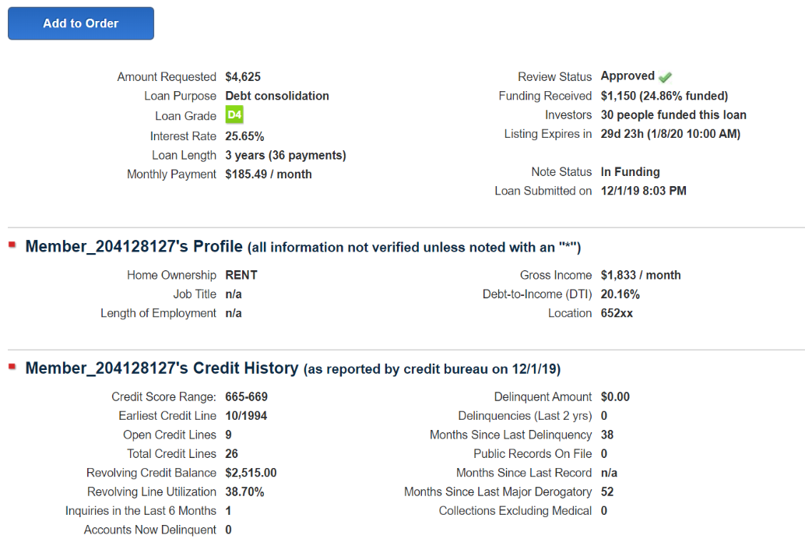
Available Data on Prospective Loans
-Additional features available for download.
-Features coincide with dataset provided by class/kaggle. Class/kaggle dataset has more features.
-Only features available for prospective loans were used in the modelling

Slide 13
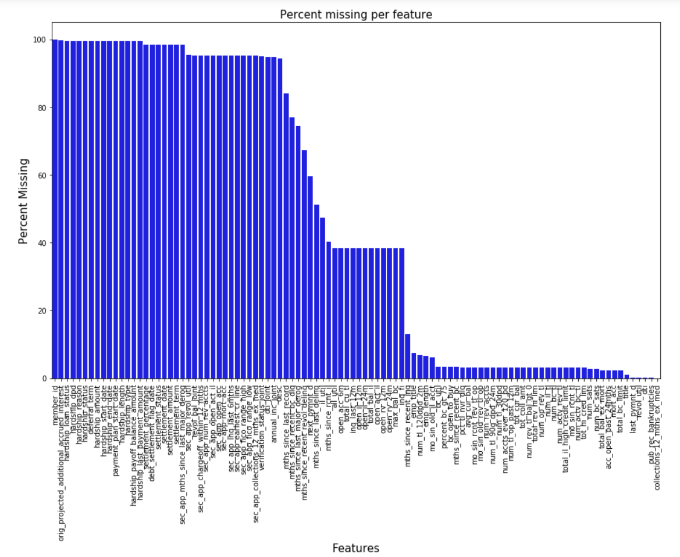
Missing Data
Dropped columns over 35% missing.
Remaining features imputed using mode for object class, and median for the rest.

Slide 14
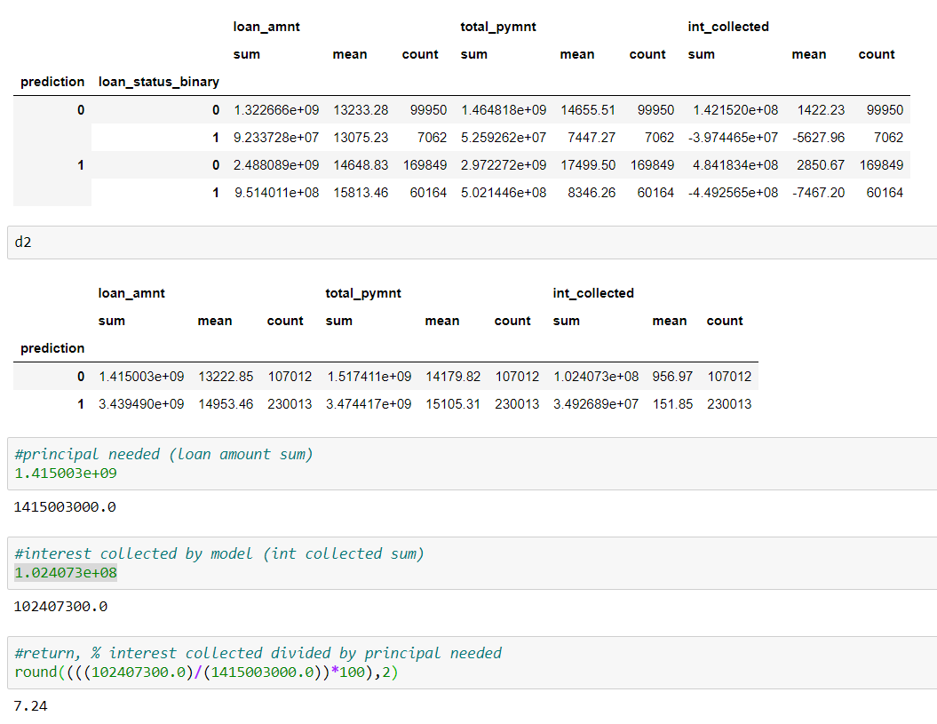
Scoring Appendix

Slide 15
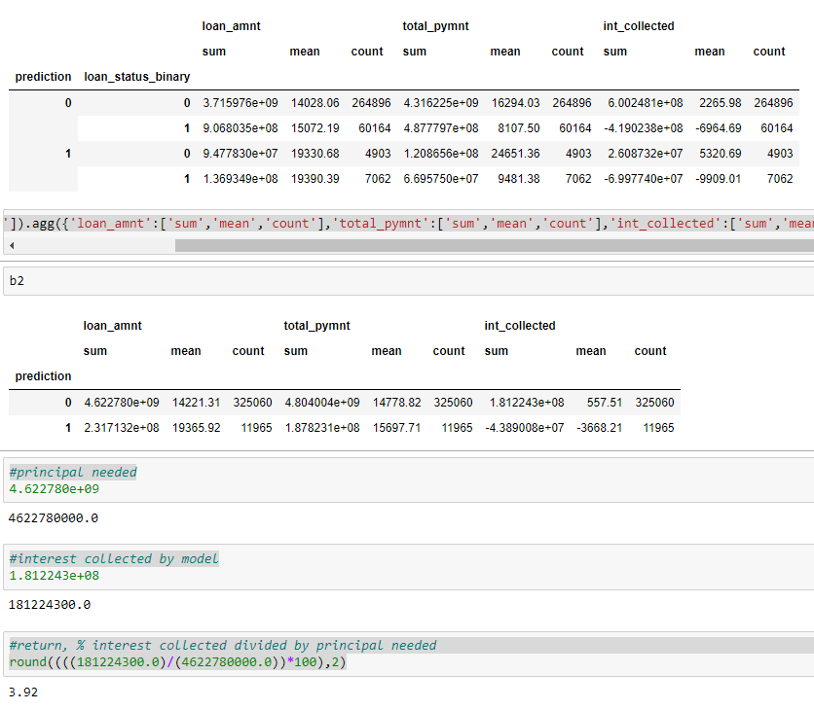
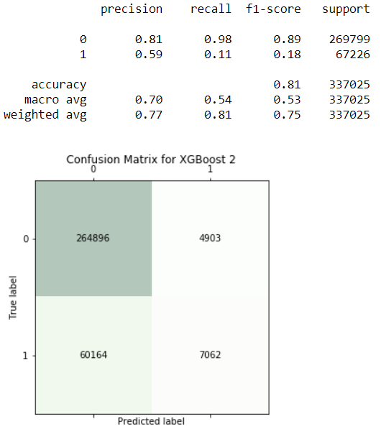
Other models: XGBoost no class weight

Slide 16
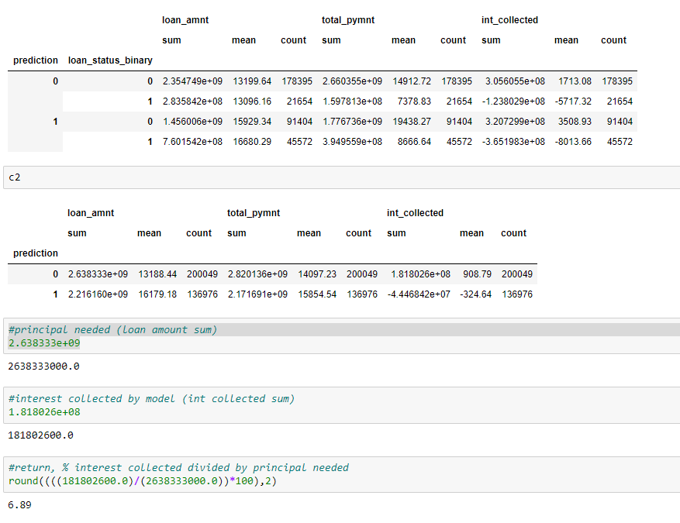
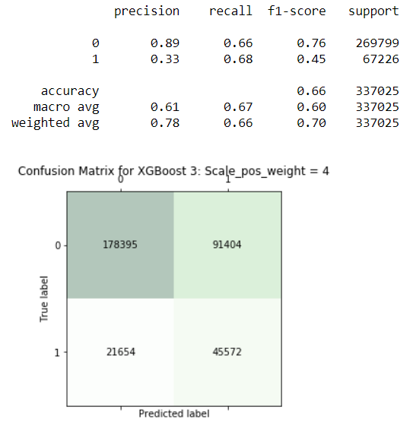
XGBoost 4 weight on positive

Slide 17
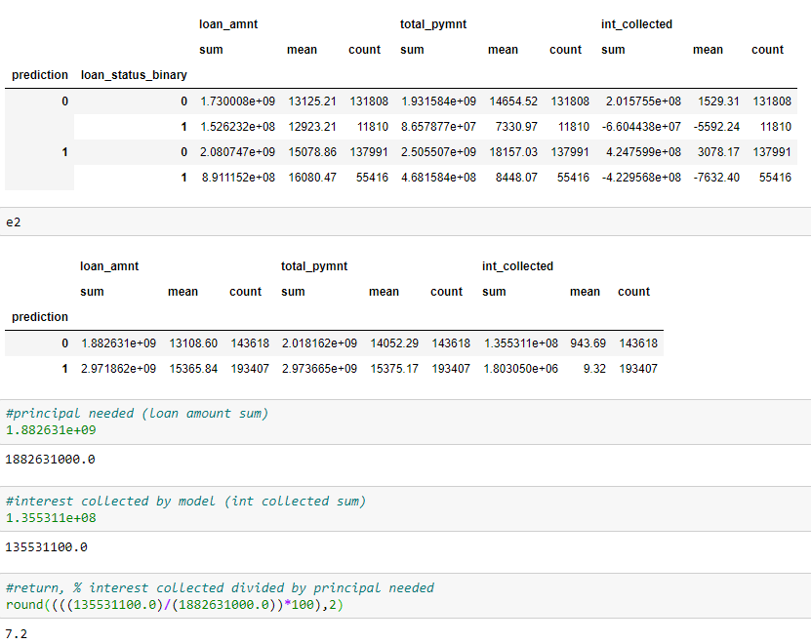
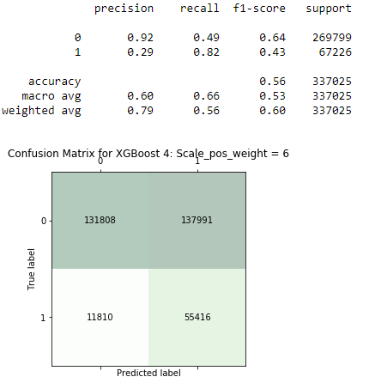
XGBoost 6 weight on positive

Slide 18
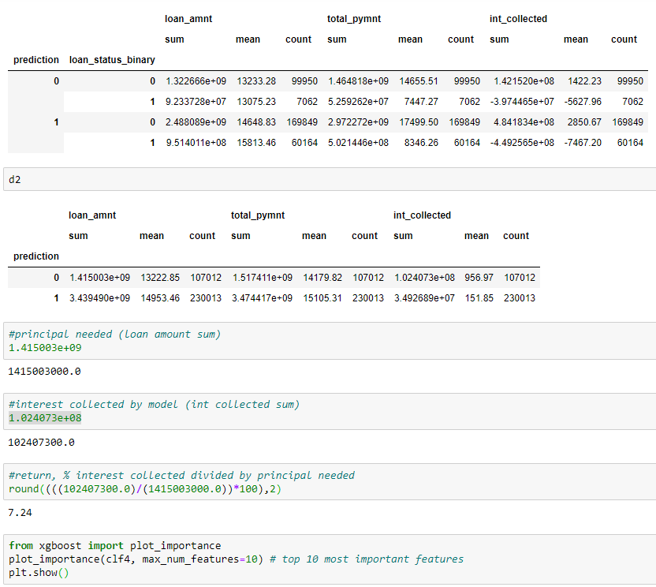
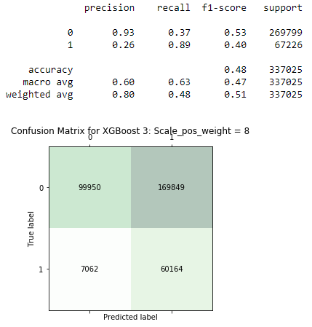
XGBoost 8 weight on positive (chosen model)

Slide 19
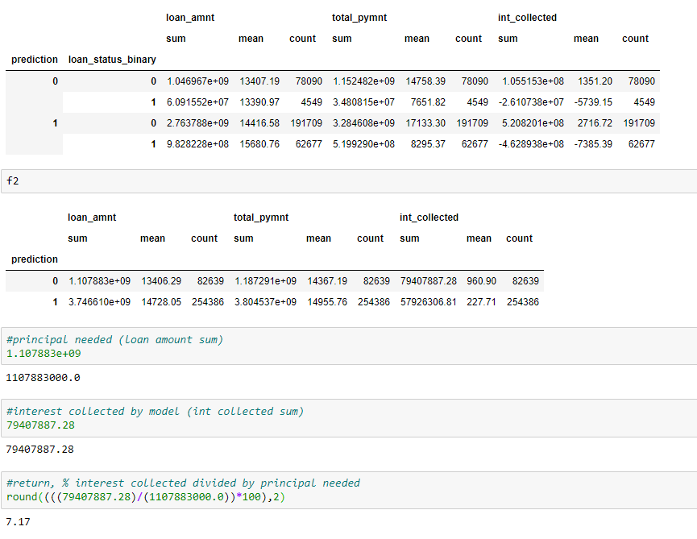
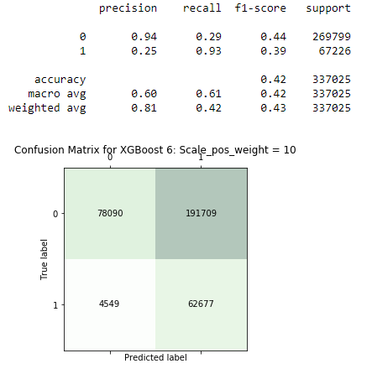
XGBoost 10 weight on positive

